Slide 1
Recursion in Python
Solving a problem by having a function call itself.

Slide 2

Recursion in Real Life Intuitive Examples
• Mirror-in-mirror reflections (self-similar images) • Ancestors defined recursively: parents + parents’ ancestors

Slide 3
What is Recursion in Programming?
• A function calls itself on smaller versions of the same problem. • Must have a base case (stopping condition). • Each call has its own local variables.

Slide 4
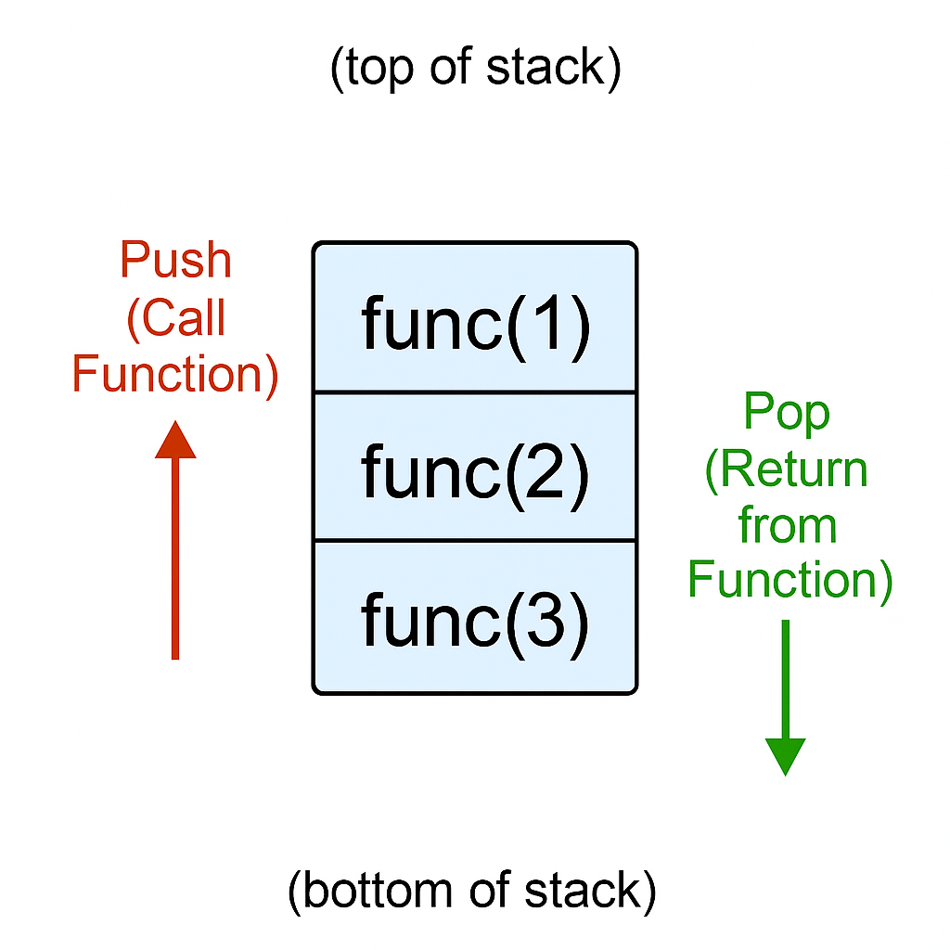
Understanding the Call Stack
• Every function call pushes a frame on the stack. • Stack is LIFO: last call made is first to finish.

Slide 5
Visualizing Recursion – factorial(3)
def factorial(n):
if n == 1: return 1
else: return n * factorial(n-1)
factorial(3)
3 * factorial(2) 2 * factorial(1) 1 (base case) 2 * 1 3 * 2
6

Slide 6
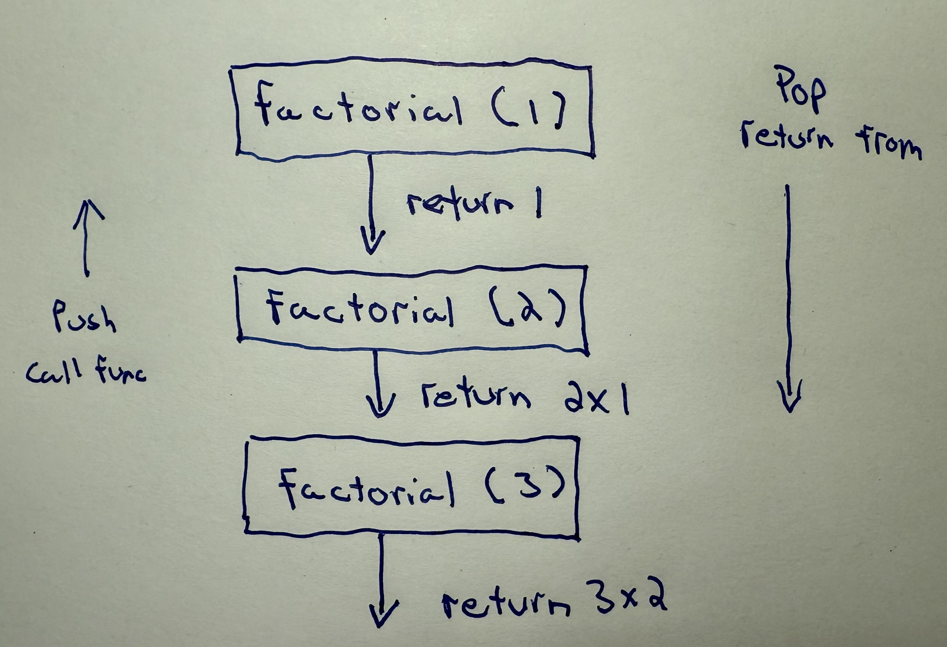

Slide 7
Example 1 – Countdown
def countdown(n): print(n) if n == 0: return countdown(n-1)

Slide 8
Example 2 – Sum of Digits
def sum_digits(n): if n == 0: return 0 return (n % 10) + sum_digits(n // 10)

Slide 9
Recursion Structure Base vs Recursive Case
Base case → stops recursion Recursive case → calls itself with smaller problem Each recursive call moves closer to the base.

Slide 10
Common Mistakes and Pitfalls
1. Missing base case → infinite recursion 2. Calling but not returning → result is None 3. Mutating shared data → unexpected results

Slide 11
Mistake 1 – Missing Base Case
def countdown(n): print(n) countdown(n-1) # ❌ No base case! → RecursionError: maximum recursion depth exceeded

Slide 12
Mistake 2 – Calling but Not Returning
def factorial(n): if n == 1: return 1 factorial(n-1) # ❌ no return print(factorial(3)) # → None

Slide 13
Mistake 3 – Mutating Shared Data
def bad_sum(lst, total=0): if not lst: return total total += lst.pop() return bad_sum(lst, total) nums = [1,2,3]

Slide 14
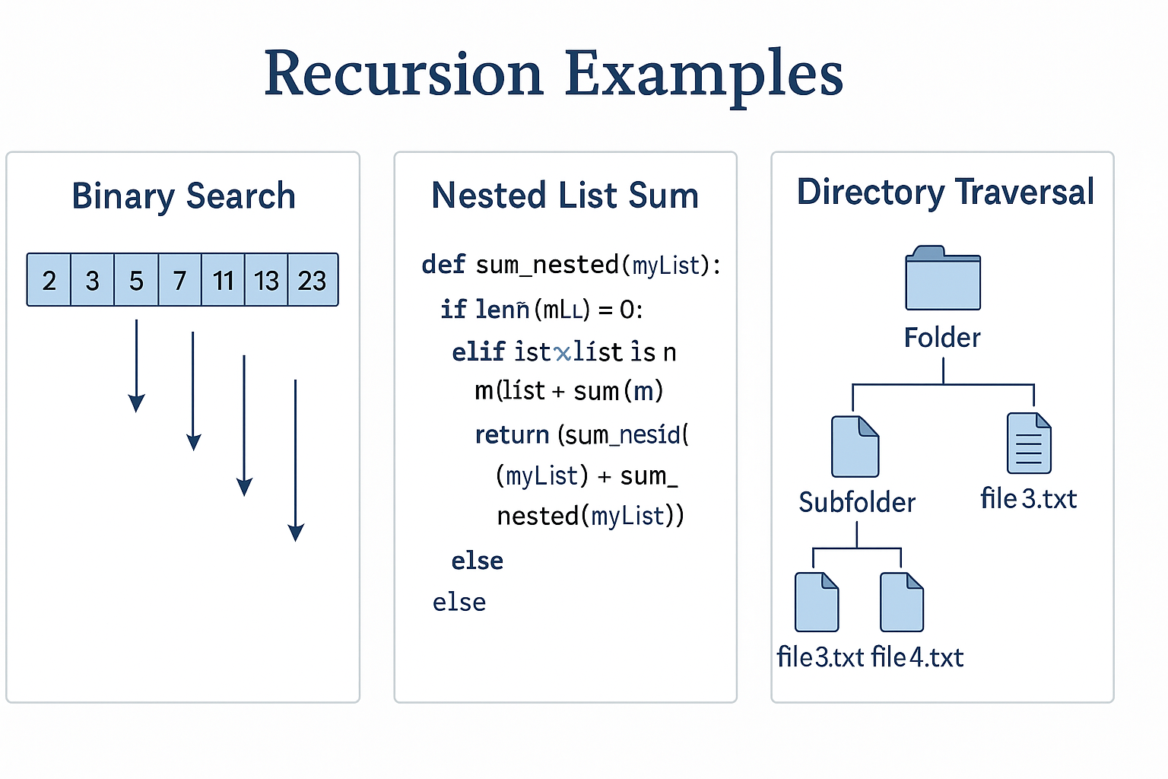
When to Use Recursion – Three Classic Examples
1. Binary Search – divide & conquer 2. Summing Nested Lists – hierarchical data 3. Tree/Directory Traversal – hierarchical structure

Slide 15
Summary and Next Steps
• Understand base and recursive cases • Trace the call stack visually • Avoid common pitfalls • Practice with Fibonacci, palindrome, nested-sum • Homework preview: write & trace your own recursive functions

